Slide 1

SMART INDIA HACKATHON 2026
INDUS-AI
Problem Statement ID – SIH26117
Problem Statement Title- Sovereign On-Premise Agentic AI Workbench using Open-Weight Multimodal LLMs for Confidential Industrial Work
Theme- Smart Automation
PS Category- Software
Team ID- 110
Team Name - Sparks

Slide 2
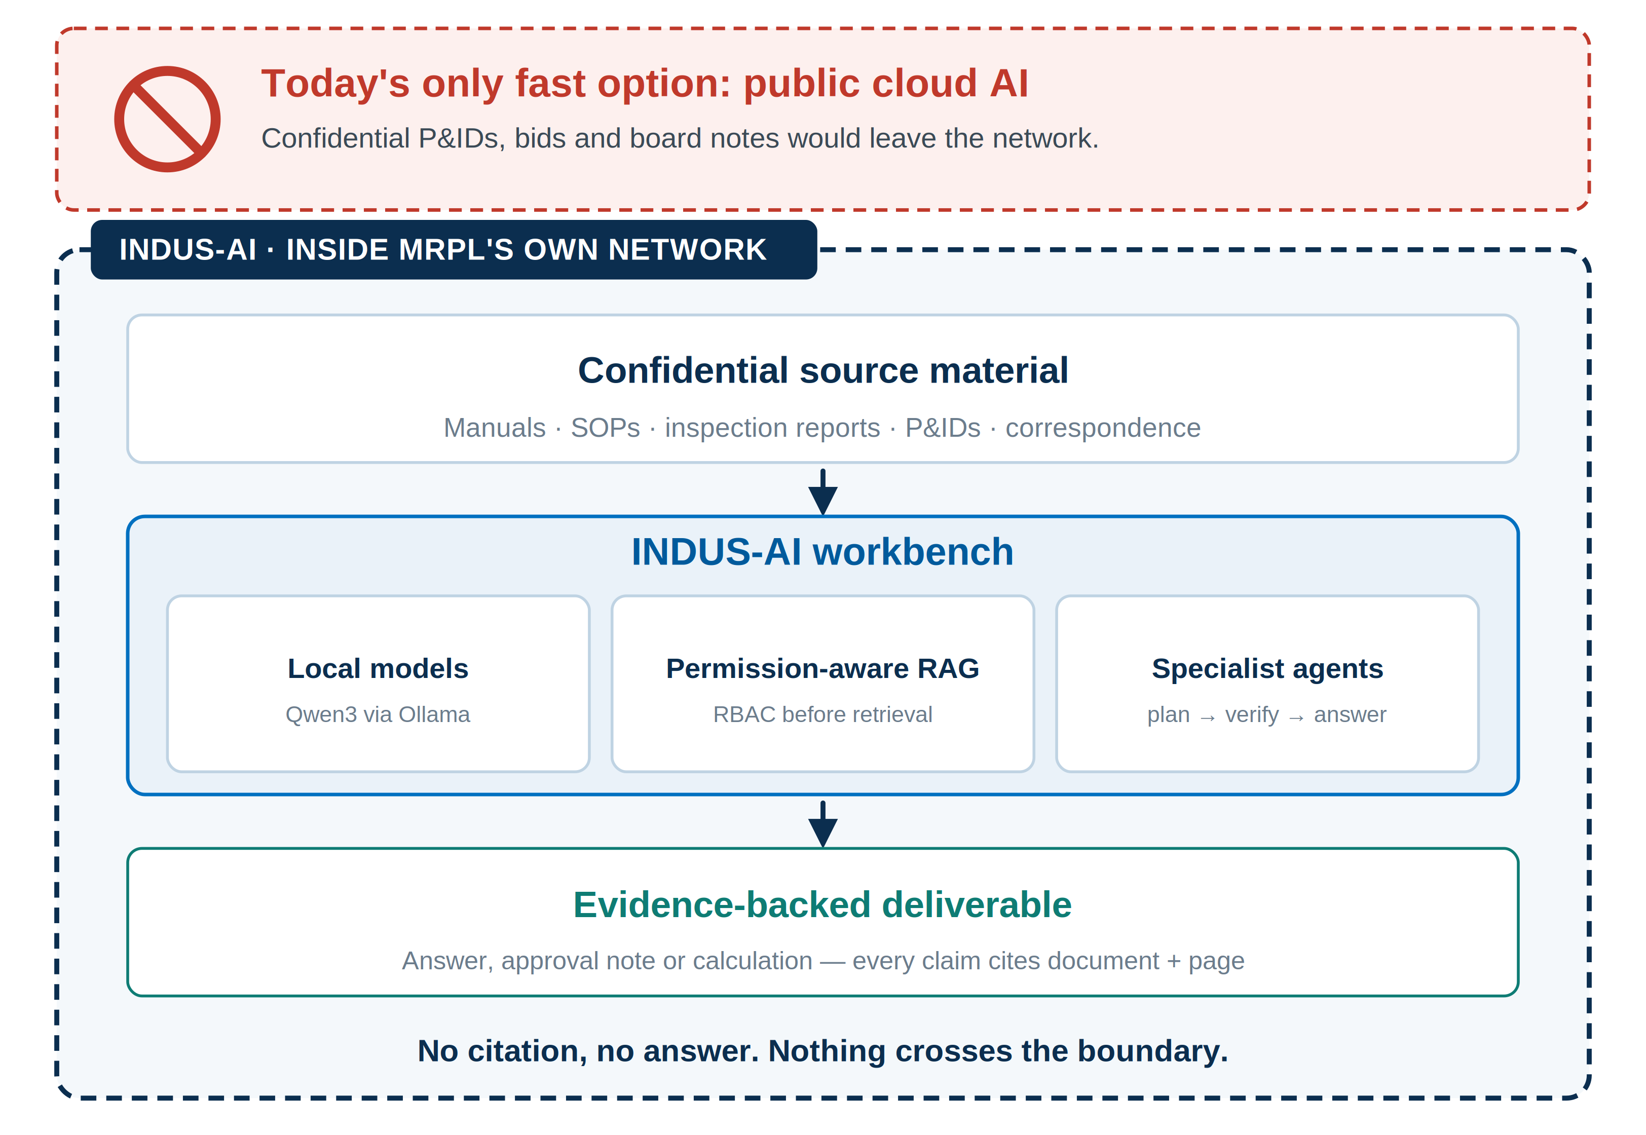
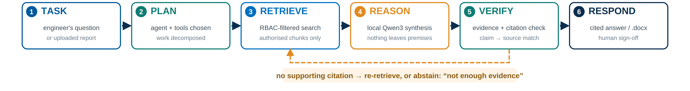
INDUS-AI — A Sovereign AI Colleague for MRPL’s Confidential Industrial Work
Sparks
The problem: MRPL's manuals, SOPs, inspection reports and P&IDs are too sensitive for cloud AI, so engineers search and cross-check them by hand today.
Our solution: A private, on-premise AI workbench — RBAC-secured knowledge base + local Qwen3-4B inference + permission-aware RAG — that answers engineering questions from MRPL's own authorized documents.
How it addresses the problem: Nothing leaves MRPL's network; access is checked before retrieval; every answer cites its source document and page instead of guessing.
Innovation and uniqueness: Evidence-first (no citation, no answer), specialist agents instead of one generic chatbot, sovereign by design, and built to extend toward multimodal + multi-model routing.
Notes:
Right-hand graphic: why the workbench has to live inside MRPL's own network. Confidential source material goes in, an evidence-backed deliverable comes out, and nothing crosses the dashed boundary. Bottom strip: the end-to-end request flow — TASK, PLAN, RETRIEVE, REASON, VERIFY, RESPOND — with the amber loop showing the evidence-first rule: if VERIFY finds no supporting citation the system re-retrieves or abstains rather than guessing.

Slide 3
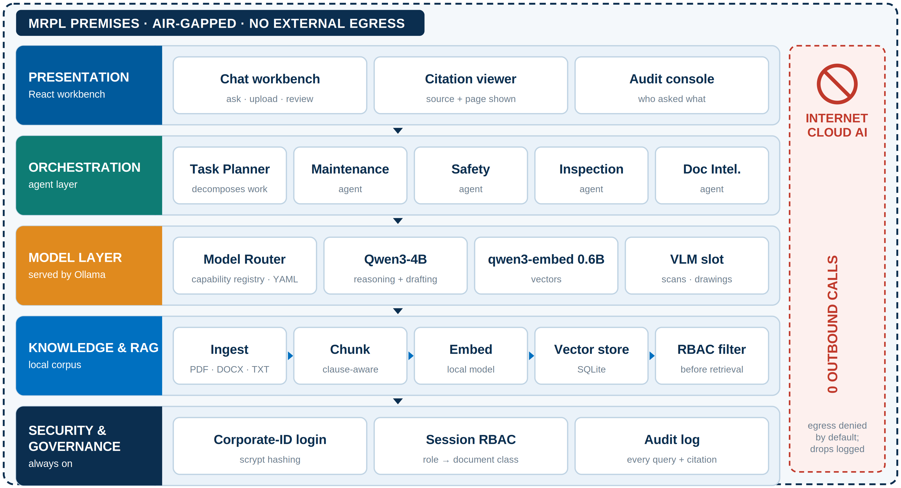
TECHNICAL APPROACH
Sparks
Frontend & orchestration: React chat interface; orchestrator runs a TASK → PLAN → RETRIEVE → REASON → VERIFY → RESPOND pipeline across specialist agents (Maintenance, Safety, Inspection, Document Intelligence).
Local AI models: Qwen3-4B for reasoning + qwen3-embedding:0.6b for embeddings, served locally through Ollama — zero external API calls for core inference.
Knowledge base & RAG: Local PDF/DOCX/TXT pipeline → chunk → embed → SQLite-backed vector store → RBAC-filtered semantic retrieval before any chunk reaches the model.
Security: Corporate-ID login, scrypt password hashing, session-based Role-Based Access Control, full audit logging.
Prototype flow: Login → Upload manual/SOP/report → Index → Ask → Retrieve (authorized only) → Answer with citation → Human review.
Every layer runs on MRPL's own hardware. A new open-weight model is added by registering it with the Model Router — a registry entry, not a redesign — and the blocked-egress strip is what the demo proves with a live network monitor.
Notes:
Architecture reads top to bottom: React workbench, agent orchestration, the model layer served locally through Ollama, the RBAC-filtered knowledge and RAG pipeline, and security and governance underneath all of it. The whole stack sits inside the dashed MRPL boundary; the red strip on the right is the sovereignty claim — zero outbound calls, egress denied by default, drops logged. The Model Router and the VLM slot are the extension points for multi-model routing and multimodal input.

Slide 4
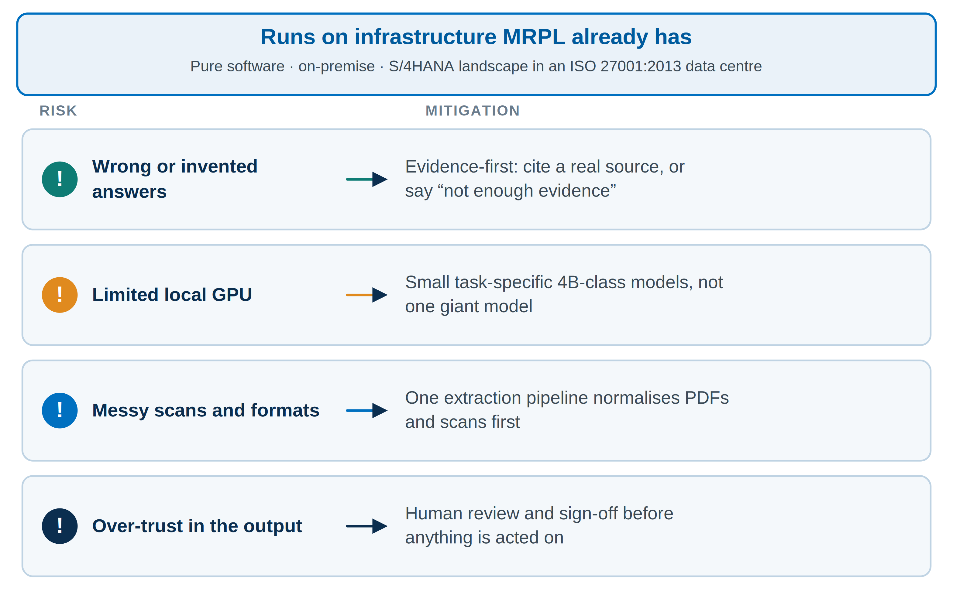
FEASIBILITY AND VIABILITY
Sparks
Feasibility: Pure software on MRPL's existing on-premise infrastructure; MRPL's SAP landscape already runs on S/4HANA and its SAP data center holds ISO 27001:2013 certification, so a secure on-prem hosting environment already exists.
Risk — wrong answers: Mitigated by evidence-first design: every answer must cite a real source, or the system says “not enough evidence.”
Risk — limited local compute: Use small, task-specific models (4B-class) instead of one giant model; start with one document type and one agent, expand later.
Risk — messy formats & over-trust: One extraction pipeline handles PDFs/scans before analysis; a human always reviews and signs off before any output is used.
Notes:
Feasibility rests on infrastructure MRPL already operates. Each identified risk is paired with the design decision that contains it, so the panel can see the mitigations were built in rather than bolted on.

Slide 5
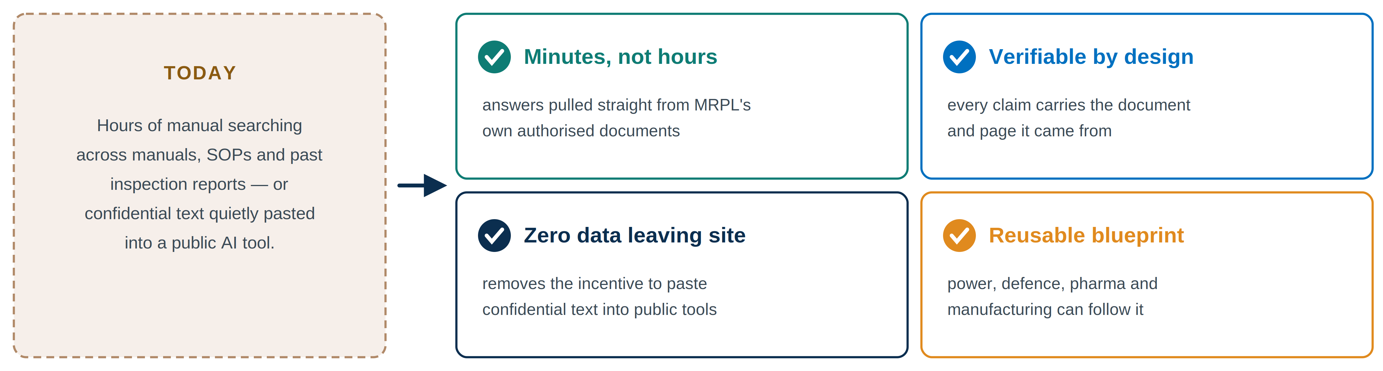
IMPACT AND BENEFITS
Sparks
Who benefits: Engineers, maintenance teams, safety officers and technical staff who currently search manuals and reports by hand.
Time & trust: Hours of manual document searching reduced to minutes, with evidence-backed answers people can verify.
Confidentiality & compliance: Nothing leaves MRPL's systems, removing the incentive to paste sensitive data into public AI tools.
Bigger picture: A reusable blueprint for how any sensitive Indian industry — power, defence, pharma, manufacturing — can adopt AI without depending on foreign cloud providers.
Notes:
Left panel is the status quo: hours of manual searching, or confidential text pasted into a public tool. The four cards are what changes — speed, verifiability, zero data leaving the premises, and a pattern other sensitive Indian industries can reuse.

Slide 6
RESEARCH AND REFERENCES
Sparks
MRPL RTI Information Manual (mrpl.co.in/rti-act) — categories of restricted vs. public MRPL documentation.
MRPL Record Retention Policy & Policy for Preservation of Documents (mrpl.co.in/Policies) — real records categories (engineering, safety, statutory).
MRPL Annual Report — confirms MRPL's SAP landscape has migrated to S/4HANA and its SAP data center holds ISO 27001:2013 certification.
Official SIH 2026 Problem Statement SIH26117.
Background research: open-weight multimodal LLMs, RAG, agentic AI, on-premise/local LLM deployment (Ollama, Qwen3).

